Slide 1
Introduction to Software Engineering
Nature of Software
Unique Nature of Web Apps
Software Engineering
Software Engineering Practices
Software Myths
Generic Process Model

Slide 2
What is Software?
Software is:
instructions (computer programs) that when executed provide desired features, function, and performance;
data structures that enable the programs to adequately manipulate information and
documentation that describes the operation and use of the programs.

Slide 3
Nature of Software
Software is an information transformer—producing, managing, acquiring, modifying, displaying, or transmitting information
Software delivers the most important product of our time—information
programmer are the same questions that are asked when modern computer-based systems are built
Why does it take so long to get software finished?
Why are development costs so high?
Why can’t we find all errors before we give the software to our customers?
Why do we spend so much time and effort maintaining existing programs?
Why do we continue to have difficulty in measuring progress as software is being developed and maintained?

Slide 4
Features of Software?
Features of such logical system:
Software is developed or engineered; it is not manufactured in the classical sense which has quality problem.
Software doesn't "wear out.” but it deteriorates (due to change). Hardware has bathtub curve of failure rate ( high failure rate in the beginning, then drop to steady state, then cumulative effects of dust, vibration, abuse occurs).
Although the industry is moving toward component-based construction (e.g. standard screws and off-the-shelf integrated circuits), most software continues to be custom-built. Modern reusable components encapsulate data and processing into software parts to be reused by different programs. E.g. graphical user interface, window, pull-down menus in library etc.

Slide 5
Wear vs. Deterioration

Slide 6
Software Applications
System software: to service other programs
E.g. Compilers, editors, file managers, OS, drivers, networking s/w etc
Application software: to solve specific business need
E.g. Transaction Processing, Manufacturing process control etc
Engineering/scientific software : to develop algorithms for real time
E.g. CAD, System Simulation
Embedded software : Software+Hardware like interface
E.g. Digital functionalities in automobile, keypad for microwave
Product-line software: to provide specific capability
E.g. Word, Multimedia applications, database etc
WebApps (Web applications) : Online
Artificial Intelligence software : to solve complex problems
E.g. Pattern Recognition, Artificial Neural Network, Game Playing etc.

Slide 7
Software—New Categories
Open world computing—pervasive, distributed computing
Ubiquitous computing— wireless networks
Net-sourcing—the Web as a computing engine
Open source—”free” source code open to the computing community (a blessing, but also a potential curse!)
Also …
Data mining
Grid computing
Cognitive machines
Software for nanotechnologies

Slide 8
Legacy Software : Older Programs
Software developed decades ago and continually modified to meet changes in business requirements and computing platforms
Software difficult and costly to maintain, risky to evolve

Slide 9
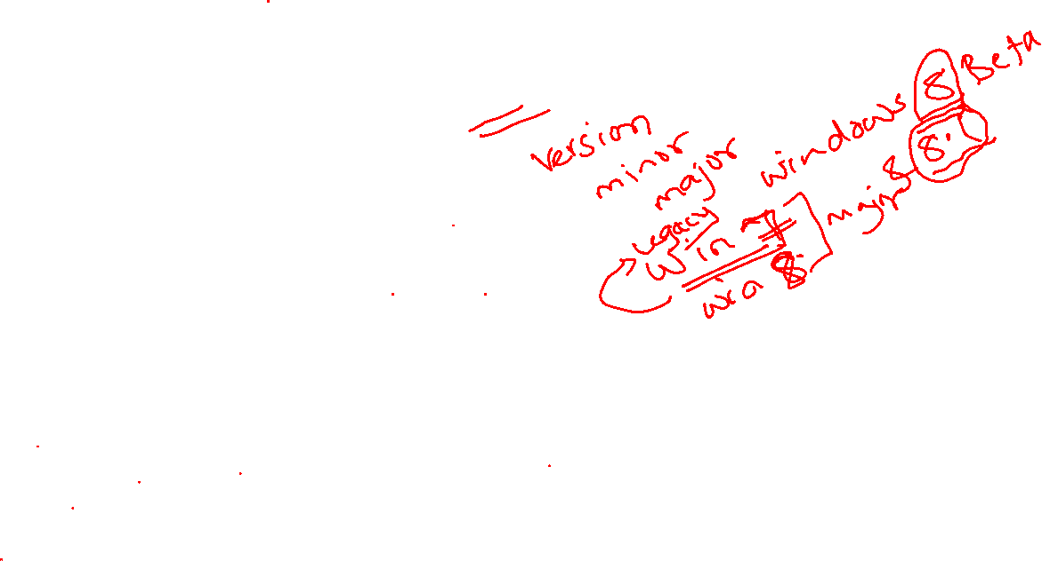
The Quality of Legacy Software
Why must it change?
software must be adapted to meet the needs of new computing environments or technology.
software must be enhanced to implement new business requirements.
software must be extended to make it interoperable with other more modern systems or databases.
software must be re-architected to make it viable within a network environment.

Slide 10

Unique Nature of Web Apps
The following attributes are encountered in the vast majority of Web Apps:
Network intensiveness
Concurrency
Unpredictable load
Performance
Availability
Data driven
Content sensitive
Continuous evolution
Immediacy
Security
Aesthetics

Slide 11
Key Points of Software Engineering
It follows that a concerted effort should be made to understand the problem before a software solution is developed.
It follows that design becomes a pivotal activity.
It follows that software should exhibit high quality.
It follows that software should be maintainable.
Software in all of its forms and across all of its application domains should be engineered.

Slide 12
Software Engineering
The IEEE definition:
Software Engineering: (1) The application of a systematic, disciplined, quantifiable approach to the development, operation, and maintenance of software; that is, the application of engineering to software. (2) The study of approaches as mentioned in (1).

Slide 13
A Layered Technology
tools
methods
process model
a “quality” focus
Software Engineering

Slide 14
Software Engineering Practice
Essence of practice
Understand the problem (communication and analysis).
Plan a solution (modeling and software design).
Carry out the plan (code generation).
Examine the result for accuracy (testing and quality assurance).
Hooker’s General Principles :
The First Principle: The Reason It All Exists
The Second Principle: KISS (Keep It Simple, Stupid!)
The Third Principle: Maintain the Vision
The Fourth Principle: What You Produce, Others Will Consume
The Fifth Principle: Be Open to the Future
The Sixth Principle: Plan Ahead for Reuse
The Seventh principle: Think!

Slide 15
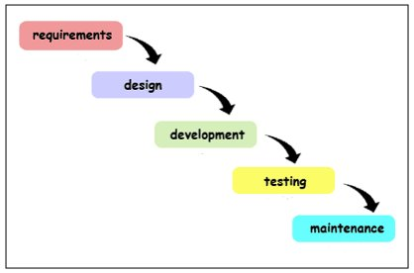

Phases in Software Development

Slide 16
The Primary Goal of Any Software Process: High Quality
Remember:
High quality ⇒ project timeliness
Why?
Less rework!

Slide 17
Software Myths
Software Management Myths
Software Customer Myths
Developer Myths

Slide 18

Software Management Myths
Myth: We already have a book that’s full of standards and procedures for building software. Won’t that provide my people with everything they need to know?
Reality: The book of standards may very well exist, but is it used? Are software practitioners aware of its existence? Does it reflect modern software engineering practice? Is it complete? Is it adaptable? Is it streamlined to improve time-to-delivery while still maintaining a focus on quality? In many cases, the answer to all of these questions is “no.”

Slide 19
Software Management Myths
Myth: If we get behind schedule, we can add more programmers and catch up (sometimes called the “Mongolian horde” concept).
Reality: Software development is not a mechanistic process like manufacturing. In the words of Brooks [Bro95]: “adding people to a late software project makes it later.” At first, this statement may seem counterintuitive. However, as new people are added, people who were working must spend time educating the newcomers, thereby reducing the amount of time spent on productive development effort. People can be added but only in a planned and well coordinated manner.

Slide 20

Software Management Myths
Myth: If I decide to outsource the software project to a third party, I can just relax and let that firm build it.
Reality: If an organization does not understand how to manage and control software projects internally, it will invariably struggle when it outsources software projects.

Slide 21
Customer Myths
Myth: A general statement of objectives is sufficient to begin writing programs—we can fill in the details later.
Reality: Although a comprehensive and stable statement of requirements is not always possible, an ambiguous “statement of objectives” is a recipe for disaster. Unambiguous requirements (usually derived iteratively) are developed only through effective and continuous communication between customer and developer

Slide 22
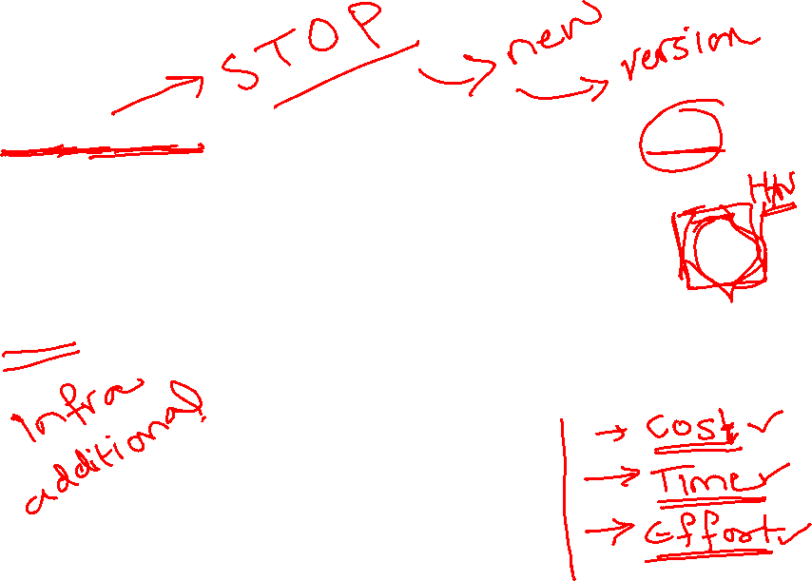
Customer Myths
Myth: Software requirements continually change, but change can be easily accommodated because software is flexible.
Reality: It is true that software requirements change, but the impact of change varies with the time at which it is introduced. When requirements changes are requested early (before design or code has been started), the cost impact is relatively small.16 However, as time passes, the cost impact grows rapidly—resources have been committed, a design framework has been established, and change can cause upheaval that requires additional resources and major design modification.

Slide 23
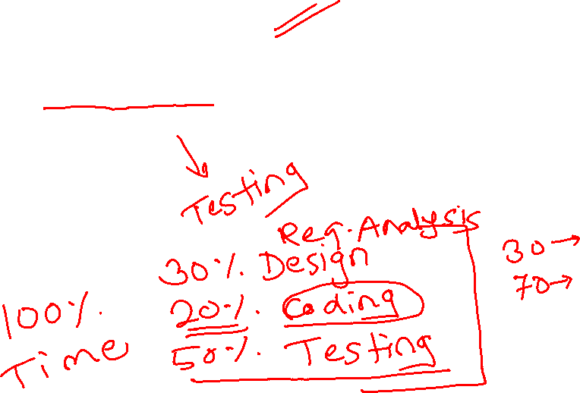
Practitioner’s myths
Myth: Once we write the program and get it to work, our job is done.
Reality: Someone once said that “the sooner you begin ‘writing code,’ the longer it’ll take you to get done.” Industry data indicate that between 60 and 80 percent of all effort expended on software will be expended after it is delivered to the customer for the first time.

Slide 24
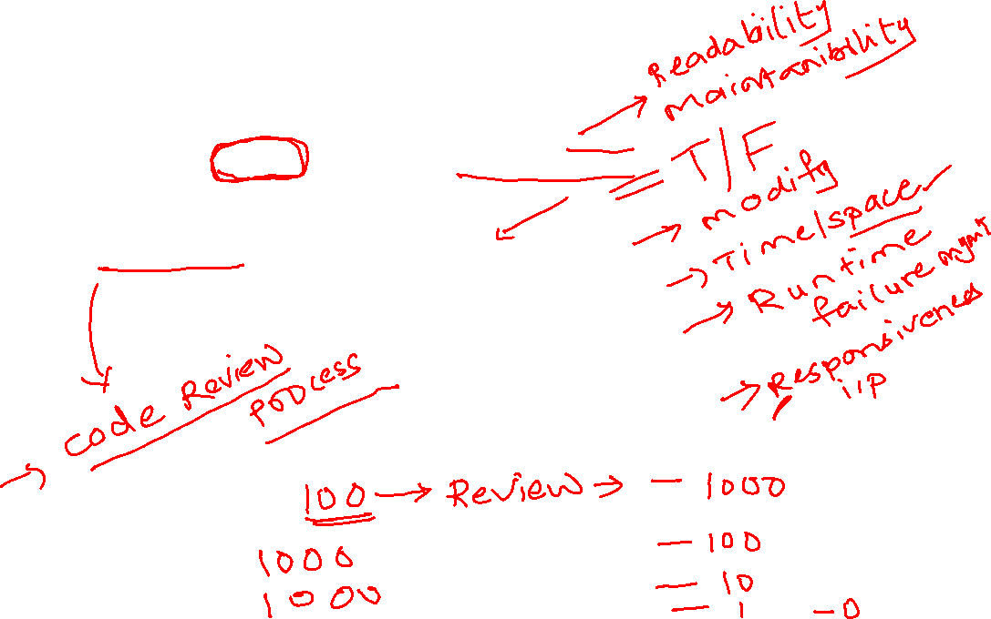
Practitioner’s myths
Myth: Until I get the program “running” I have no way of assessing its quality.
Reality: One of the most effective software quality assurance mechanisms can be applied from the inception of a project—the technical review. Software reviews (described in Chapter 15) are a “quality filter” that have been found to be more effective than testing for finding certain classes of software defects.

Slide 25
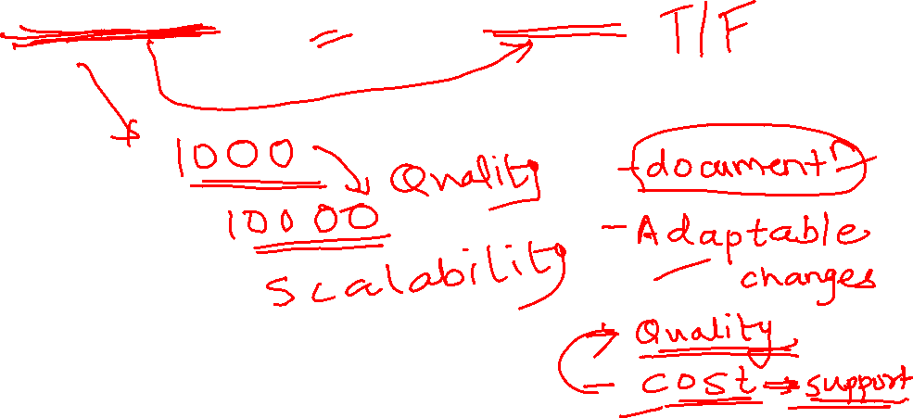
Practitioner’s myths
Myth: The only deliverable work product for a successful project is the working program.
Reality: A working program is only one part of a software configuration that includes many elements. A variety of work products (e.g., models, documents, plans) provide a foundation for successful engineering and, more important, guidance for software support.

Slide 26

Practitioner’s myths
Myth: Software engineering will make us create voluminous and unnecessary documentation and will invariably slow us down.
Reality: Software engineering is not about creating documents. It is about creating a quality product. Better quality leads to reduced rework. And reduced rework results in faster delivery times.

Slide 27
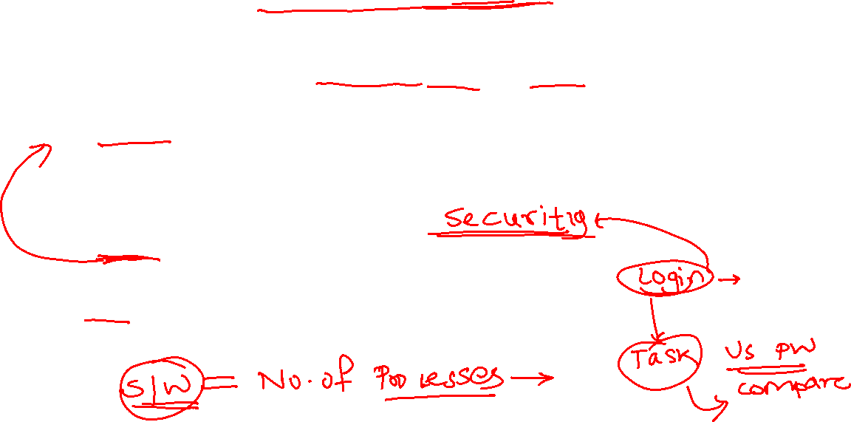
Definition of Software Process
A process is a collection of activities, actions, and tasks that are performed when some work product is to be created
An activity strives to achieve a broad objective (e.g., communication with stakeholders) and is applied regardless of the application domain, size of the project, complexity of the effort, or degree of rigor with which software engineering is to be applied.
An action (e.g., architectural design) encompasses a set of tasks that produce a major work product (e.g., an architectural design model).
A task focuses on a small, but well-defined objective (e.g., conducting a unit test) that produces a tangible outcome.

Slide 28
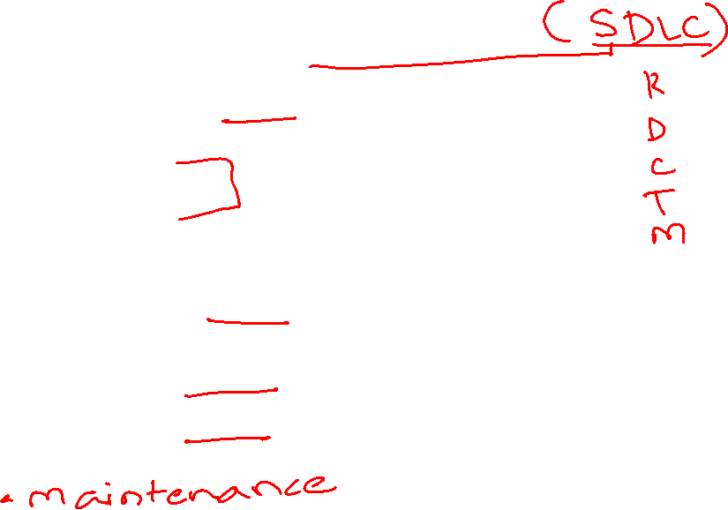
Generic Process Model
Communication
Planning
Modeling
Analysis of requirements
Design
Construction
Code generation
Testing
Deployment

Slide 29

Umbrella Activities
Complement the five process framework activities and help team manage and control progress, quality, change, and risk.
Software project tracking and control: assess progress against the plan and take actions to maintain the schedule.
Risk management: assesses risks that may affect the outcome and quality.
Software quality assurance: defines and conduct activities to ensure quality.
Technical reviews: assesses work products to uncover and remove errors before going to the next activity.
Measurement: define and collects process, project, and product measures to ensure stakeholder’s needs are met.
Software configuration management: manage the effects of change throughout the software process.
Reusability management: defines criteria for work product reuse and establishes mechanism to achieve reusable components.
Work product preparation and production: create work products such as models, documents, logs, forms and lists.

Slide 30
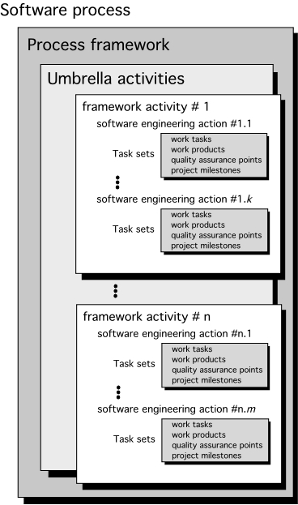
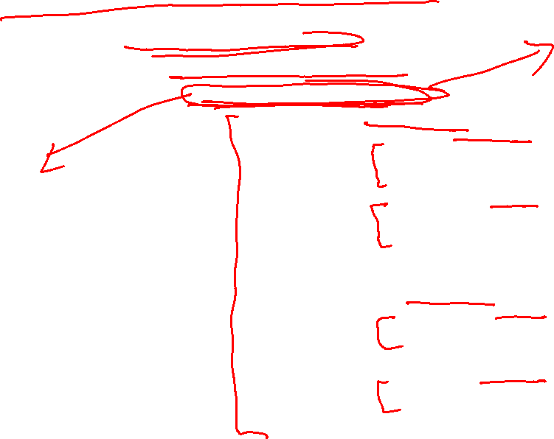
A Process Framework

Slide 31

Identifying a Task Set
Before you can proceed with the process model, a key question: what actions are appropriate for a framework activity given the nature of the problem, the characteristics of the people and the stakeholders?
A task set defines the actual work to be done to accomplish the objectives of a software engineering action.
A list of the task to be accomplished
A list of the work products to be produced
A list of the quality assurance filters to be applied

Slide 32
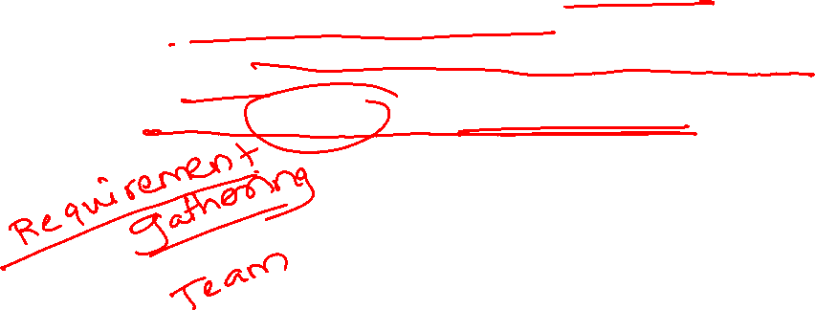
Identifying a Task Set
For example, a small software project requested by one person with simple requirements, the communication activity might encompass little more than a phone all with the stakeholder. Therefore, the only necessary action is phone conversation, the work tasks of this action are:
1. Make the contact with stakeholder via telephone.
2. Discuss requirements and take notes.
3.Organize notes into a brief written statement of requirements.
4. E-mail to stakeholder for review and approval.

Slide 33

Example of a Task Set for Elicitation
The task sets for Requirements gathering action for a simple project may include:
Make a list of stakeholders for the project.
Invite all stakeholders to an informal meeting.
Ask each stakeholder to make a list of features and functions required.
Discuss requirements and build a final list.
Prioritize requirements.
Note areas of uncertainty.

Slide 34
Example of a Task Set for Elicitation
The task sets for Requirements gathering action for a big project may include:
Make a list of stakeholders for the project.
Interview each stakeholders separately to determine overall wants and needs.
Build a preliminary list of functions and features based on stakeholder input.
Schedule a series of facilitated application specification meetings.
Conduct meetings.
Produce informal user scenarios as part of each meeting.
Refine user scenarios based on stakeholder feedback.
Build a revised list of stakeholder requirements.
Use quality function deployment techniques to prioritize requirements.
Package requirements so that they can be delivered incrementally.
Note constraints and restrictions that will be placed on the system.
Discuss methods for validating the system.
Both do the same work with different depth and formality. Choose the task sets that achieve the goal and still maintain quality and agility.

Slide 35

Prescriptive Process Models
Often referred to as “conventional” process models
Prescribe a set of process elements
Framework activities
Software engineering actions
Tasks
Work products
Quality assurance and
Change control mechanisms for each project
There are a number of prescriptive process models in operation
Each process model also prescribes a workflow
Various process models differ in their emphasis on different activities and workflow

Slide 36
Adapting a Process Model
The process should be agile and adaptable to problems. Process adopted for one project might be significantly different than a process adopted from another project (to the problem, the project, the team, organizational culture). Among the differences are:
the overall flow of activities, actions, and tasks and the interdependencies among them
the degree to which actions and tasks are defined within each framework activity
the degree to which work products are identified and required
the manner which quality assurance activities are applied
the way project tracking and control activities are applied
the overall degree of detail and rigor with which the process is described
the degree to which the customer and other stakeholders are involved with the project
the level of autonomy given to the software team
the degree to which team organization and roles are prescribed

Slide 37

Prescriptive and Agile Process Models
The prescriptive process models stress detailed definition, identification, and application of process activates and tasks. Intent is to improve system quality, make projects more manageable, make delivery dates and costs more predictable, and guide teams of software engineers as they perform the work required to build a system.
Unfortunately, there have been times when these objectives were not achieved. If prescriptive models are applied dogmatically and without adaptation, they can increase the level of bureaucracy.
Agile process models emphasize project “agility” and follow a set of principles that lead to a more informal approach to software process. It emphasizes maneuverability and adaptability. It is particularly useful when Web applications are engineered.

